Slide 1
Biochemistry

Slide 2
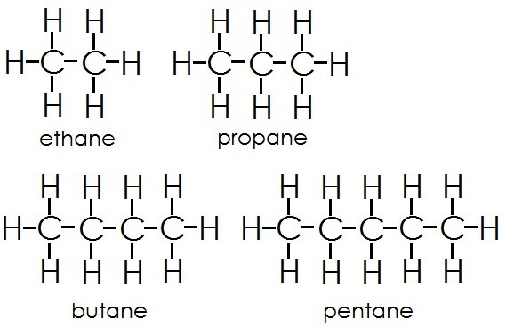
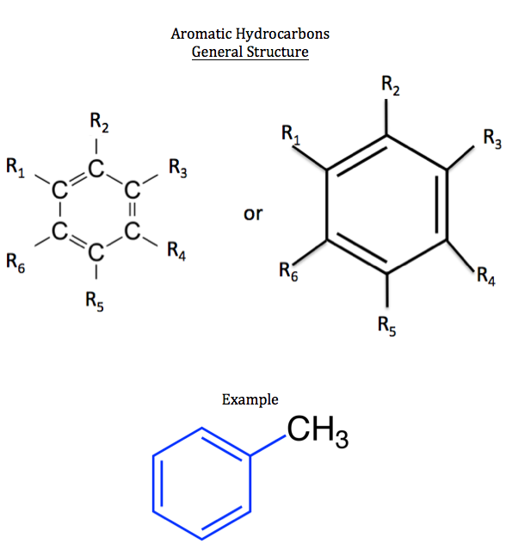
Organic Compounds
Contains carbon (and hydrogen)- CO₂ is not organic.
Organic means “from life”
Base: Carbon/hydrogen backbones are called hydrocarbons
Functional groups- elements attached to these hydrocarbons to give the compound its identity. (involved in chemical reactions, determines properties of organic compounds)
Important: carbon always makes 4 bonds (may be single, double, etc)

Slide 3
Functional Groups
The 7 functional groups that are most important in biology
(use “R” as a variable)
Hydroxyl group
Carbonyl group (keytone/aldehyde)
Carboxyl group
Amino Group
Sulfhydryl group (thiol)
Phosphate group
Methyl group

Slide 4
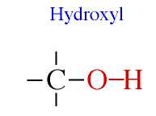
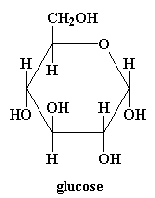
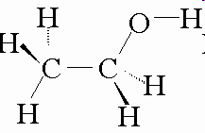
Hydroxyl Group
  Found in alcohols (ex. ethanol) and sugars
  Polar/Hydrophilic - increases the solubility of molecules
  OH (not OH⁻ hydroxide ion)
  Where are the Hydroxyl groups in the glucose and in the ethanol?
ethanol

Slide 5
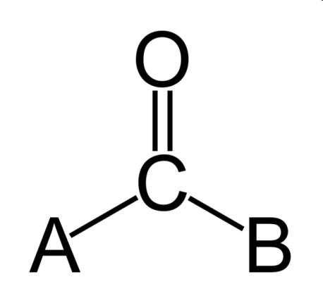
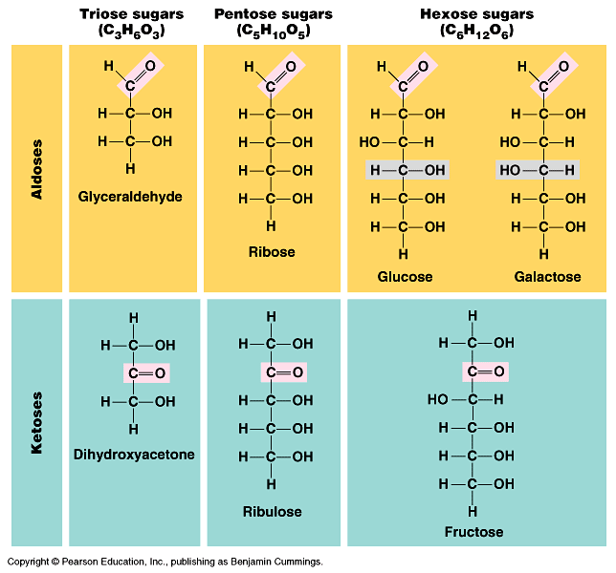
Carbonyl Group
Found in Carbohydrates:
Two types
  Aldehyde
    terminal
  Ketone
    internal
  Polar/Hydrophilic

Slide 6
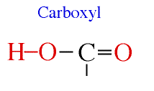
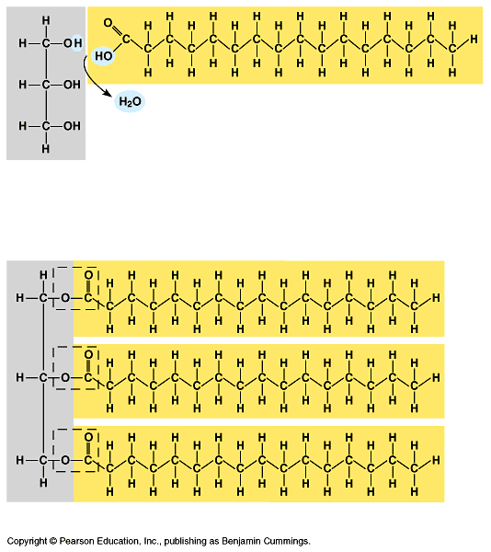
Carboxyl Group
AKA- Carboxylic Acid
Acidic properties- can release H into a solution
Double Bond between Carbon and Oxygen
Single Bonds: Carbon to Hydroxyl
Written as COOH or C02H
Polar/Hydrophilic

Slide 7
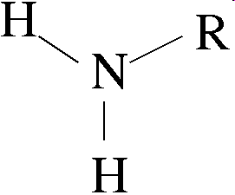
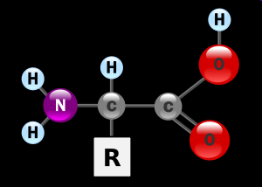
Amino Group
Amino Group
  In every amino acid
  Nitrogen atom attached to two hydrogen atoms
  Basic- accepts H from solutions
  Polar/hydrophilic

Slide 8
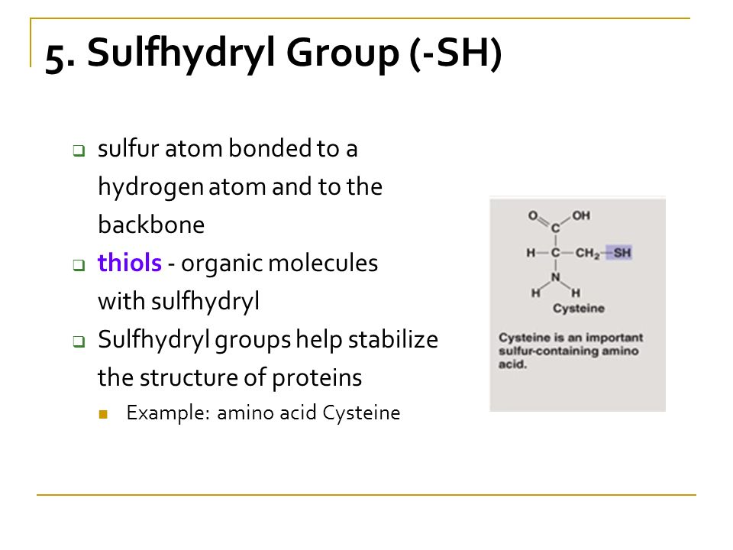
Sulfhydryl group (thiol)
Polar/hydrophilic

Slide 9
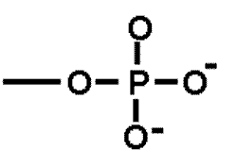
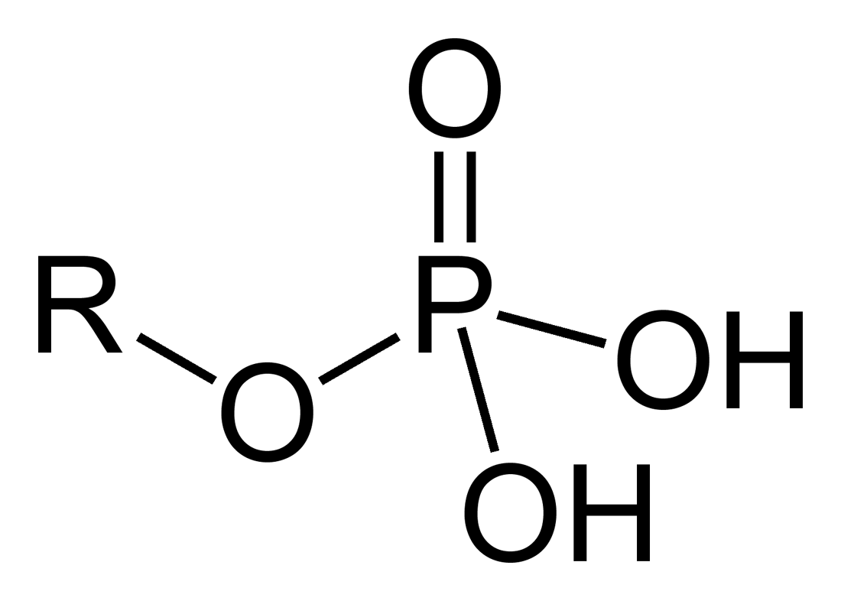
Phosphate group (PO4)
Acidic- loses H
Charged
Polar/hydrophilic
Involved in energy transfers- (ATP)
In Nucleic Acids, phospholipids

Slide 10
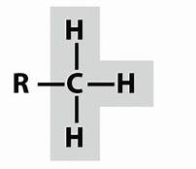
Methyl group----CH3
NonPolar/hydrophobic
Important in Gene Expression

